Slide 1





WE CONNECT
LINK WITH US
Calenda Link
WE CONNECT
WE CONNECT
WE CONNECT

Slide 2












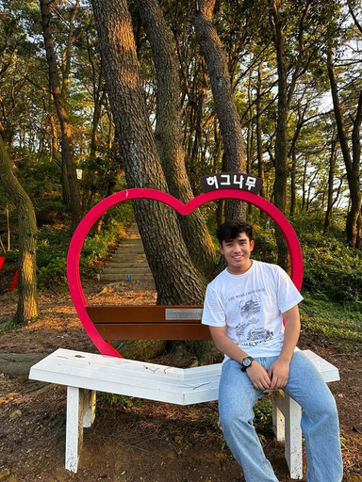



Team Leader
CalendaLink
Connecting schedules, empowering collaboration - CalendaLink simplifies your time
SUN
MON
TUE
WED
THU
FRI
SAT
01
02
03
04
05
06
07
08
09
10
11
12
13
14
Faiz
Faiz - 2022320144
Afiqah
Syuhada
Anis
Dyana
15
16
17
18
20
21
Afiqah - 2022320153
Nurul Syuhada - 2022320107
22
23
24
25
26
27
28
Nur Syuhada - 2022320091
Farah Dyana - 2022320038
Educational Content
Anis - 2022320060
29
30
01
02
03
04
05
Apiz - 2022320015
Syuhada
Apiz
Fizu
Fizu - 2022320144

Slide 3







02
Problem to Solve
CALENDALINK | DATA COMMUNICATION
Lack of real-time synchronization
Poor user
experience (UX)
Inefficient collaboration & conflict management
Notes:
syushou
-
chew
- address the challenge of creating a more user-friendly system environment by focusing on seamless and efficient data communication
- interaction between users and systems often involves a constant flow of data—whether it's real-time updates, notifications, or collaborative inputs
- many systems fail to streamline this communication, leading to inefficiencies, user frustration, and a steep learning curve.
- One of the core problems we’ve identified is the lack of intuitive design in how data is transmitted, displayed, and interacted with.
aekay
- Coordinating schedules among groups, such as teams, friends, or family, is time-consuming and error-prone.
- Users often struggle to merge individual calendars into one shared view.
Why its matter?
Miscommunication or double-booked schedules can lead to missed deadlines, reduced productivity, and frustration in personal or professional relationships.

Slide 4
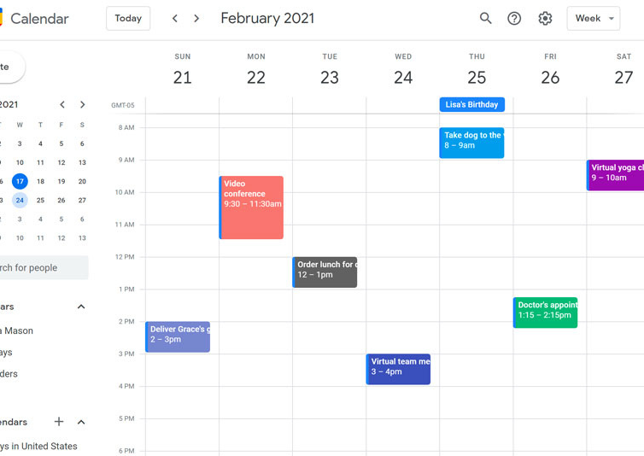
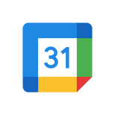
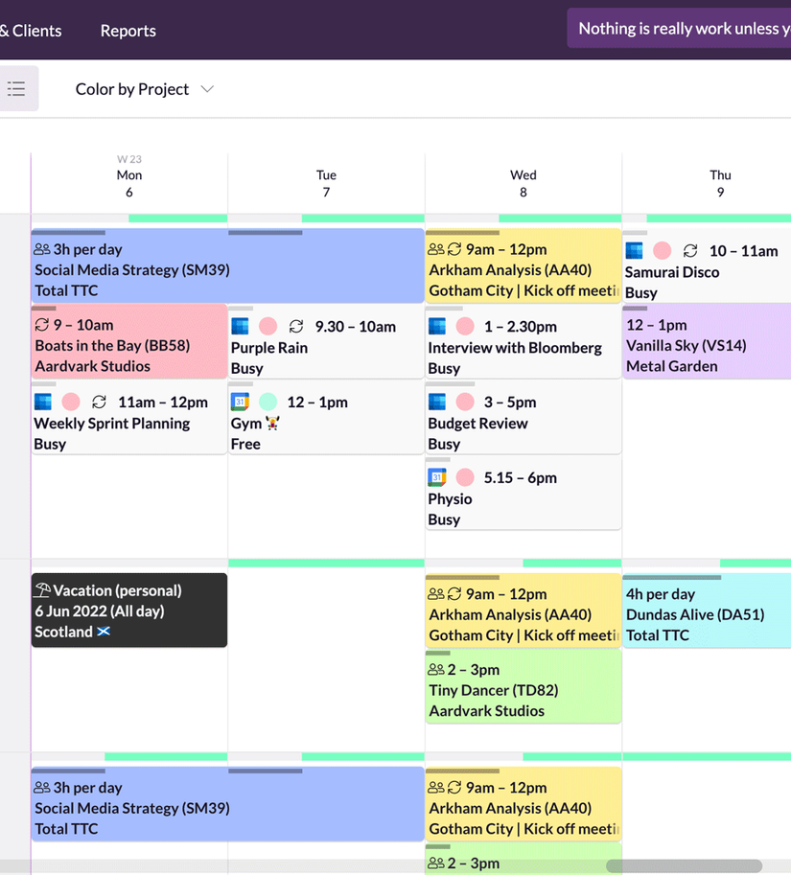
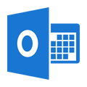
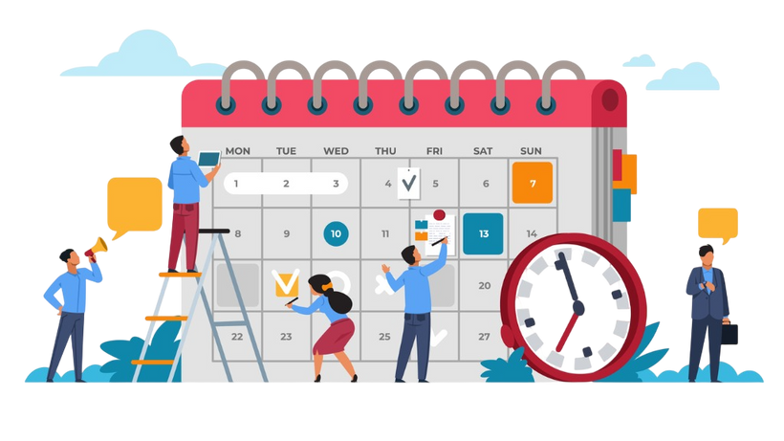
03
CALENDALINK | DATA COMMUNICATION
Limitations of Existing Problem
Google Calendar
Provide shared calendars, but limited collaborative tools
Microsoft Outlook Calendar
Good for work teams, but overly complex
for personal or informal use
Apple Calendar
Events shared by others appear
as separate, unmerged entries
Notes:
syushou
chew
- Lack of Focus on Collaboration
Google Calendar: It does provide shared calendars, but its collaborative tools are somewhat limited in terms of real-time communication, role management, and streamlined coordination for group events. Users often have to rely on third-party apps for more advanced collaborative workflows.
Your Opportunity: Emphasize features like seamless real-time updates for shared calendars, enhanced role-based reminders (e.g., team leader vs. member notifications), and integration of communication tools directly into your calendar for better collaboration.
ak
Existing Solutions:
Google Calendar: Offers sharing but lacks robust features for combining multiple calendars into one seamless view.
Microsoft Outlook Calendar: Good for work teams but overly complex for personal or informal use.
Group Chat Apps: Users share events informally, leading to messy coordination.
Limitations:
- Lack of real-time updates when events are changed by one user.
- Difficulty in merging multiple calendars into one consolidated timeline.

Slide 5




04
CALENDALINK | DATA COMMUNICATION
Methodology
SMTP Protocol
STMP handles email-based notifications for calendar events
TCP/IP Protocol
TCP ensures the reliable delivery of both email and real-time update
FrontEnd & BackEnd
DNS Protocol
The React frontend communicates with the Express node.js backend
The backend interacts with MongoDB to fetch and store event data, ensuring a seamless experience for users
DNS is used to resolve human-readable domain names to IP addresses
HTTPS Protocol
Ensures that all communication between the frontend and
backend, as well as the third-party services are secure
Notes:
chew
- frontend (react.js)
-backend (express.js, node.js)
- mongodb (database)
- protocol (https)
- smtp
- tcp
syushou
ak
- Shared events appear in real-time with notifications when updates are made
- Merge feature combines multiple calendars into a single view for group coordination

Slide 6








05
CALENDALINK | DATA COMMUNICATION
Results of Solution
Account Management
Personal Calendar
Users can register and log in to create and manage their own accounts securely.
Developed a separate personal calendar to help users manage their own events without confusion.
Friend Connections
Users can connect with new friends by:
Adding their email.
Sending a verification code to establish a sharing agreement for events.
Notes:
Account Management
Users can register and log in to create and manage their own accounts securely.
Combined Calendar
Created a combined calendar that aggregates all events from friends for a shared and collaborative view.
Friend Connections
Users can connect with new friends by:
Adding their email.
Sending a verification code to establish a sharing agreement for events.
Personal Calendar
Developed a separate personal calendar to help users manage their own events without confusion.
Event Management
Users can delete unwanted events, and changes will be synchronized across:
Their personal calendar.
The combined calendar shared with others.
Upcoming Events & Notifications
Displays a list of upcoming events with:
Real-time notifications for important updates or reminders.

Slide 7




05
CALENDALINK | DATA COMMUNICATION
Results of Solution
Event
Management
Combined
Calendar
Upcoming
Events
& Notifications
Users can add new events and delete unwanted
events and changes will
be synchronized across:
Their personal calendar.
The combined calendar is shared with others.
Created a combined calendar aggregating all events from friends for a shared and collaborative view.
Displays a list of upcoming events with
real-time notifications for important
updates or reminders.
.
Notes:
Account Management
Users can register and log in to create and manage their own accounts securely.
Combined Calendar
Created a combined calendar that aggregates all events from friends for a shared and collaborative view.
Friend Connections
Users can connect with new friends by:
Adding their email.
Sending a verification code to establish a sharing agreement for events.
Personal Calendar
Developed a separate personal calendar to help users manage their own events without confusion.
Event Management
Users can delete unwanted events, and changes will be synchronized across:
Their personal calendar.
The combined calendar shared with others.
Upcoming Events & Notifications
Displays a list of upcoming events with:
Real-time notifications for important updates or reminders.

Slide 8

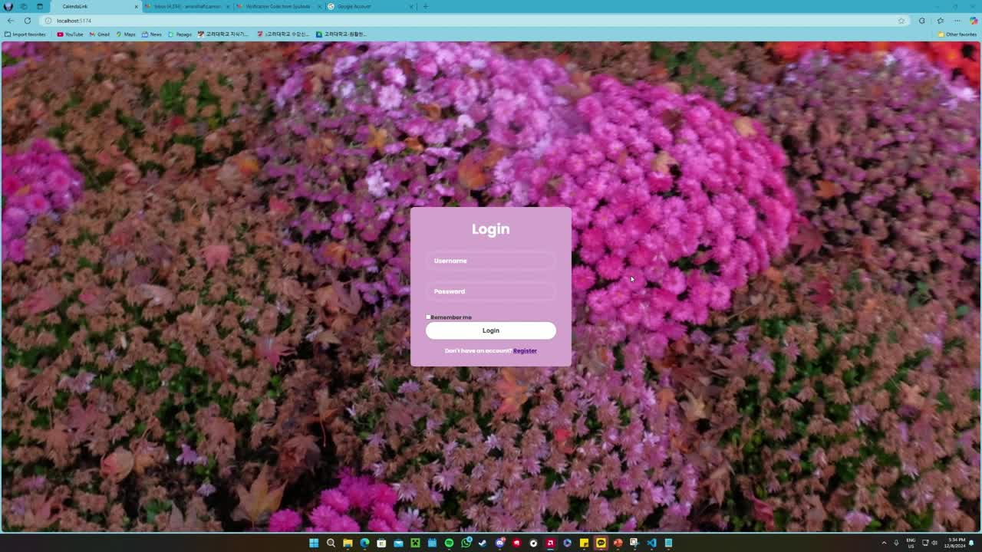


Demo Video
By CalendaLink

